Slide 1
Community Centres Investment Fund 2024
Refurbishment Grant
Information Event
25th June 2024

Slide 2
Yvonne Philbin
  Department of Rural and Community Development

Slide 3

Community Centres Investment Fund 2024 – Refurbishment Grant
Pre-application Information Event
Housekeeping
Tech issues: please phone 01 511 7222 or email onlinesupport@pobal.ie
Your microphone and camera will be turned off for the event
Comments and questions: please use the Q&A function
This session will be recorded.
Video will be available plus more resources: gov.ie - Community Centres Investment Fund

Slide 4
Agenda
Overview of the fund
Eligibility
Preparing your application
How applications are assessed
Project Finances & Budget
Registration for Online Application portal
Questions and Answers
Supports, Key dates and Resources

Slide 5
Overview of the fund

Slide 6
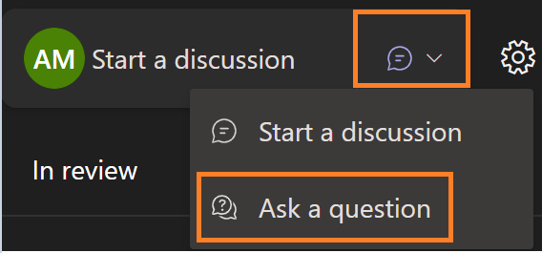
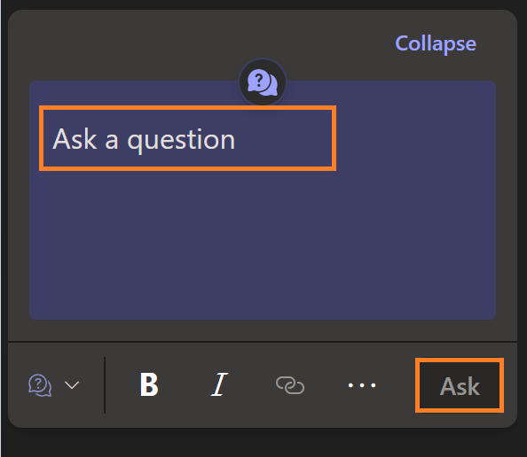
Q&A Function
2
3
1
4
5
onlinesupport@pobal.ie

Slide 7


Community Centres Investment Fund 2024
Minister Humphreys has secured €20m in capital funding in 2024 to improve our Community Centres.
This fund will cover the upgrade and refurbishment of community buildings.
This is an investment in both rural and urban communities across the Country.

Slide 8
Aim of the fund and grants available
To deliver high quality capital projects for Community Centres that will benefit local communities
Grants Available:
Category 1: Small scale projects - Grants from: €10,000 to €25,000
Category 2: Larger scale projects - Grants from €25,001 to €100,000

Slide 9
What the new fund covers (Page 1 of 2)
Funding is available for capital works such as:
Costs associated with building/renovation works.
Works to improve communal facilities such as kitchen and toilet facilities.
Retrofitting/energy upgrade projects that improve the usability or longevity of the facility and reduce energy bills.
Upgrades to lighting systems and stage areas.
Works to address safety concerns, including upgrades to meet fire/ building regulations.

Slide 10
What the new fund covers (Page 2 of 2)
Funding is available for capital works such as:
Purchase of equipment necessary for the ongoing success of the project following completion e.g. kitchen appliances for a kitchen renovation project, improved lighting, installation of a lift to improve access etc.
Improvements to assist in providing additional or better services to the community e.g. repurposing existing space, kitchen upgrades etc.
Works to improve access for all within the facility.
Essential maintenance works e.g. roof repairs etc.

Slide 11

Who can apply?
(Page 1 of 2)
A Community Centre is ''a building that is managed by a community-based organisation which is open to and used by a broad range of individuals and groups within the local community for group activities such as social events, information/supports and recreation.​
Applicants must be not-for-profit community and voluntary sector organisations.
The centre must be currently used by community groups.

Slide 12
Who can apply?
(Page 2 of 2)
Centre may be owned/managed by a single purpose organisation (youth, elderly, sports etc), but applicant must be able to clearly demonstrate that they are currently open to, and currently used by the wider community for a variety of activities.​
Example: A facility where the organisation rent/offer the centre spaces out to a broad range of local groups and may have facilities such as a hall, kitchen, meeting rooms, stage etc. They are locations where members of the wider local community gather for group activities, social supports/events, information, and other purposes.

Slide 13
Eligibility

Slide 14

Eligible Organisation's
Not-for-profits and community and voluntary orgs.
Established for a minimum of 2 years prior to application opening date.
Incorporated and Unincorporated organisations
Must have a Tax Reference Number (TRN) and a Tax Clearance Access Number (TCAN)
Centre must be open to and used by the wider community for a variety of activities

Slide 15

Ineligible
Organisation's
Private, commercial, for-profit companies, trusts, foundations, individuals
Community enterprise centres
Remote Working Hubs
Childcare, statutory education facilities
Statutory bodies
Organisations that received funding under CCIF 2022 but have not submitted their final report by the 21st August 2024

Slide 16

Ineligible Activities
New-build projects​
Community centres that are not already currently in use by the wider community for a variety of activities​
Relocation of community centres from one space to another​

Slide 17

Evidence required with application
Organisational Governance documentation e.g. M&A
Planning permission (if required)
If building is not owned by applicant:
  Building owner permission to undertake project
  Rental agreement for:
    Category 1: 5 years*
    Category 2: 7 years*
  *from the date the project will be completed
Match funding:
  Category 1: 5% match funding of total project costs
  Category 2: 10% match funding of total project costs
  Quotes – 1 quote for each significant cost item (i.e. €5k or above)

Slide 18
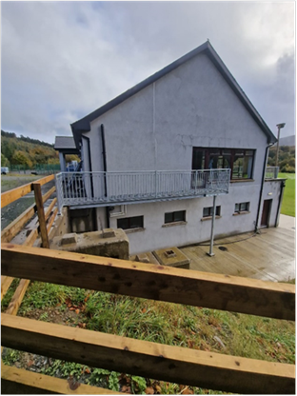
Example CCIF 2022: Ballinacor Community Project
Category: 1
Grant Amount: €25,000
Where: Co. Wicklow
Need Identified:
The main entrance to the upper floor of the building presented a health and safety risk. Fire escapes were required on both sides of the building.
CCIF Impact:
Health and safety concerns have been addressed and the closure of the centre for not meeting building regulations has been prevented
40-50% increase in the usage of the centre for meetings, social events and activities.

Slide 19
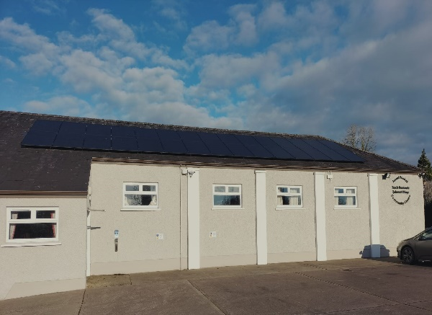
Example CCIF 2022: Tydavnet Village Community Centre
Category: 2
Grant Amount: €52,697
Where: Co. Monaghan
Need Identified:
There was a leaking roof into the kitchen facilities.
Need to reduce energy costs for the centre.
A new stage light & sound system was required to hold community events.
CCIF Impact:
Roof repairs allowed the Centre to continue catering for community activities and events and to cater for over 100 people who attend their Elderly Lunch Club weekly.
The installation of solar panels has seen a significant drop in energy bills.
The new lighting system has benefitted drama and other community entertainment events.

Slide 20
Preparing your application

Slide 21


How to Apply:
Download Guidelines and sample Application Form from: www.gov.ie/CommunityCentresFund
Applicants must register on the portal in advance of submitting application
Online application opens: 29 July 2024
Online application closing date: 29 August 2024

Slide 22

Before completing your Application Form
Read the application form, the Application guidelines and the FAQs once available
Attend the support events
Gather the required documentation
Register for a TRN and TCAN if you don't already have one

Slide 23

Preparing your application
We suggest you start drafting the text for your answers now!
You can copy and paste the information across when the online application opens.
Consider aim and criteria for funding and information requested
Read the Selection Criteria (p 16 of Applicant Guidelines)
Gather the information and supporting documents required (p. 12 Guidelines)
Be clear about what you propose to do with the grant

Slide 24

Writing your application
Assume the reader knows nothing about your organisation
Be clear on how the funding will make necessary improvements to better serve the community.
Use simple language
Allow sufficient time to gather information and supporting docs, and to write and review your application.

Slide 25
How applications are assessed

Slide 26

Selection Criteria | Weighting
Demonstration of need | 40%
Value for money | 25%
Achievability & viability | 25%
Governance | 10%

Slide 27
Selection Criteria | All applicants must demonstrate and outline the following in their proposal:
Demonstration of need (40%) | The extent to which it is demonstrated that the Centre/ Facility is open to and used by the wider community. Need for works/equipment is evidenced. Local involvement and views considered. Works/equipment will directly benefit the community.
Value for Money (25%) | Budget: detailed, complete, relevant to work. Costs outlined are relevant to improve the facility. The project will make a difference to all the community, particularly most marginalised.

Slide 28

Achievability and viability (25%) | Relevant experience and expertise. Project oversight. Risk management. The project achievable within the timeframe. The full costs of project be in place. Shovel ready!
Governance (10%) | Board/committee capacity. Track record of managing funding. Appropriate procedures and controls in place.

Slide 29
Project Finances and Budget

Slide 30
Grant Thresholds:
Category 1: The grant amount that can be applied for is between €10,000 and €25,000.
Category 2: The grant amount that can be applied for is between €25,001 and €100,000.

Slide 31
Match Funding requirements
Example Category 1
Total Project Cost: €21,000
Grant Amount: €19,950
Match Funding: €1,050
For Category 1: 5% of the total project budget is required as match funding
For Category 2: 10% of the total project budget is required as match funding
This can be sourced from:
Internal resources / current cash reserves.
Letter of offer for loan.
Offer of funding from Parent Organisation
NOTE: Funds from other government sources, or the EU cannot be used as match funding or to co-fund CCIF projects in this round.
Example Category 2
Total Project Cost: €55,000
Grant Amount: €49,500
Match Funding: €5,500

Slide 32

Costs
Indicative eligible costs for both Category 1 and 2 include:
Costs associated with building/renovation works.
Costs associated with acquisition, installation or replacement of equipment which forms an integral part of a building.
Costs associated with improving the energy efficiency of the building.
Improvements to facilities in order to meet fire safety and building regulations
Costs associated with improving disability access within the building
Professional fees for works-related service providers up to 12.5% of the total project cost. E.g., engineers, architects, quantity surveyors.

Slide 33
Costs
Eligible costs points to note:
All costs included for this grant must be:
Directly related to the project being applied for.
Third party and verifiable by an invoice and receipt for payment, and audit trail showing procurement requirements have been met.
Incurred by the end of the project delivery date (From 1 January 2025 to 31 March 2026 for Category 1, and to 30th June 2026 for Category 2).

Slide 34

Costs
Ineligible Costs:
Sporting Infrastructure
Car parks/ Outside Works
Office or ICT equipment
Costs not directly related to the project.
Indirect costs of the project e.g., community organisation staff time spent working on the project in an administrative capacity.
Core costs, including overheads.
Purchase of land or buildings.
VAT where applicants are registered for VAT.
Costs incurred before/after timeframe or not directly related.

Slide 35

Quotation documentation for applications
A minimum of 1 professionally prepared quote or pre-tender estimate for all costs of €5,000 or above.
Quote from contractor/supplier.
Estimate prepared by technical supervisor e.g., engineer, quantity surveyor or architect.
Equipment: picture/screenshot from a catalogue or website.

Slide 36
Public procurement requirements
Procurement rules for works and related services
Works Related Services (i.e. engineering services, architects, project management, quantity surveying etc)
<€5k: Seek 1 written quotation
€5k to €50k : Seek 5 written tenders
> €50k: Open Procedure. Publish on etenders
Supplies & Services
<€5k : Seek 1 written quotation
€5,000 to €50,000: Seek 3 written quotations
>€50k: Publish on etenders
Works
<€5k: Seek 1 written quotation
€5k to €200k: Seek 5 written tenders
>€200k: Open Procedure. Publish on etenders
Further Information:​
Government Procurement Guidelines on Goods and Services – here
Construction procurement – www.constructionprocurement.gov.ie​
Costs which require an e-tender - www.etenders.gov.ie

Slide 37

Financial Returns
Financial Returns
Financial returns will be completed online.
Costs must be incurred with work taking place within delivery period and payments should be made in full by final date of 31st March 2026 for Category 1 and 30th June for Category 2.

Slide 38

Payment Schedule for Category 2
Payment Schedule for Category 1
90% once grant agreement signed, applicable conditions fulfilled.
10% paid retrospectively when end of programme financial and progress reports have been submitted and approved.
All payments will be paid retrospectively in a maximum of 3 installments.
Applicants may be paid in less than 3 instalments, if they provide evidence that the project budget has been spent in fewer than 3 claims.
The First payment will be made once a minimum of 30% of total project expenditure has been spent and the interim financial and progress reports have been submitted and approved.
Another payment can be made when the next interim financial and progress report have been submitted and approved (min 30%).
The last payment will be made when the end of programme financial and progress reports have been submitted and approved.
Example of Category 1 Payment Schedule
Category 1 Grant is €20,000 – you will receive €18,000 once conditions are fulfilled and the balance of €2,000 once final return submitted / approved.

Slide 39
Registration

Slide 40
Primary Authorised User (PAU)
Who?
  Member of the Board
  Member of the Committee
Why?
  PAU will be the person who will have access to sign the contract if your organisation is successful
Notes:
If you already have a Primary Authorised User set up for Pobal contract or application process. You do not need to do this again. Log in to check your details. If you are unsure what role you have, contact onlinesupport@pobal.ie
Once application is live, the PAU can set up other users as Administrators to complete and submit the application form
Take you through the set up which is now available as a video

Slide 41

The link to the Application Portal can be found on the Department Website.
https://myportal.pobal.ie/
User Type: Primary Authorised User
PAU must be on the Board or Committee
Choose appropriate Role
Notes:
Job Title: Board Member, Chairperson, Committee Member, Treasurer

Slide 42
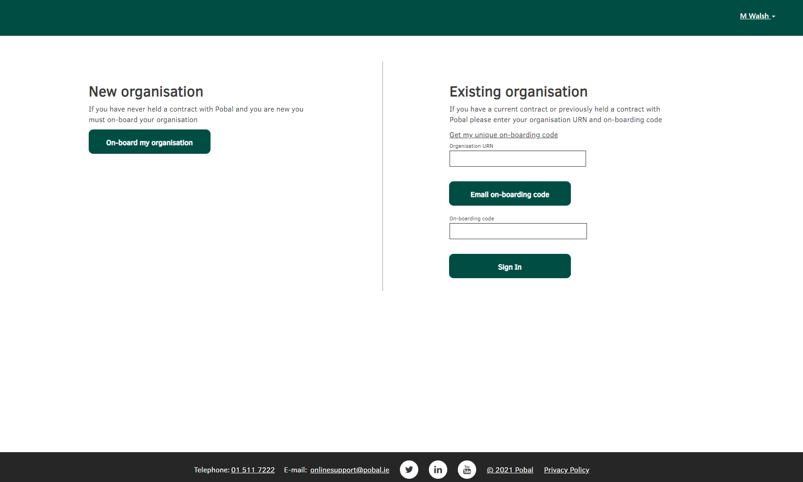

Slide 43
Requirements for Registration
All organisations will be required to provide a Tax Reference Number (TRN) and a Tax Clearance Access Number (TCAN) for Portal Registration.
If you do not already have a TRN and TCAN, please ensure you register for this as a matter of urgency. Refer to the Revenue website here.

Slide 44
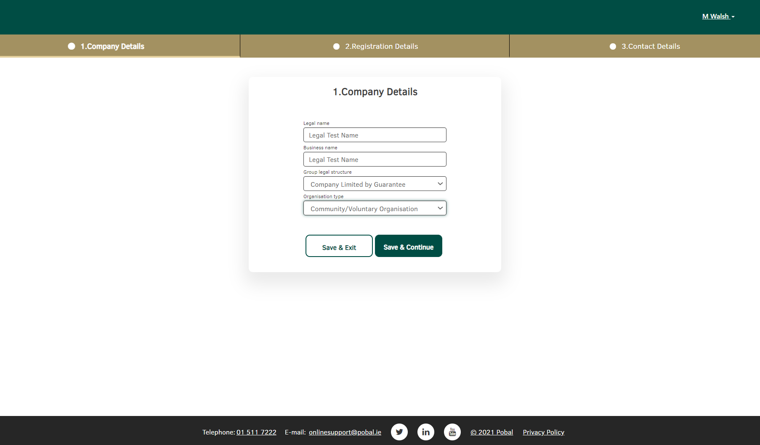
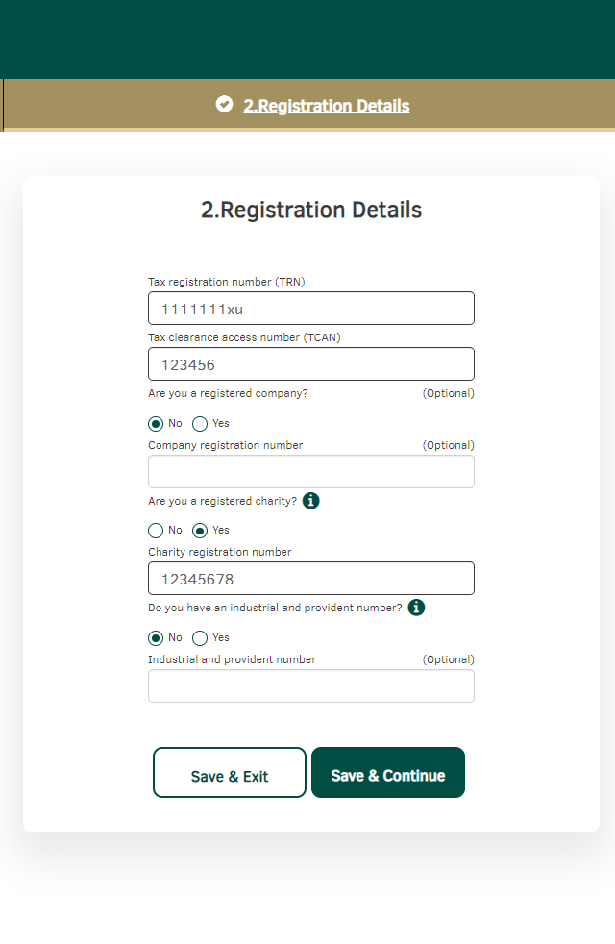
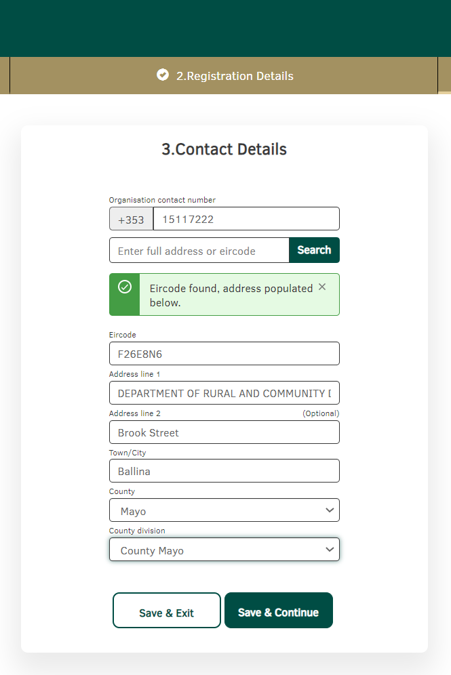
Notes:
Tax Reference Number – Need to have this to register on our portal system and it will also be needed to pay any successful organisation's.

Slide 45

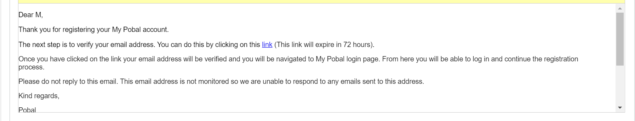
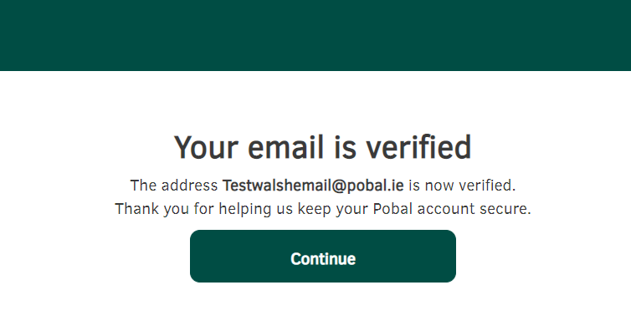

Slide 46
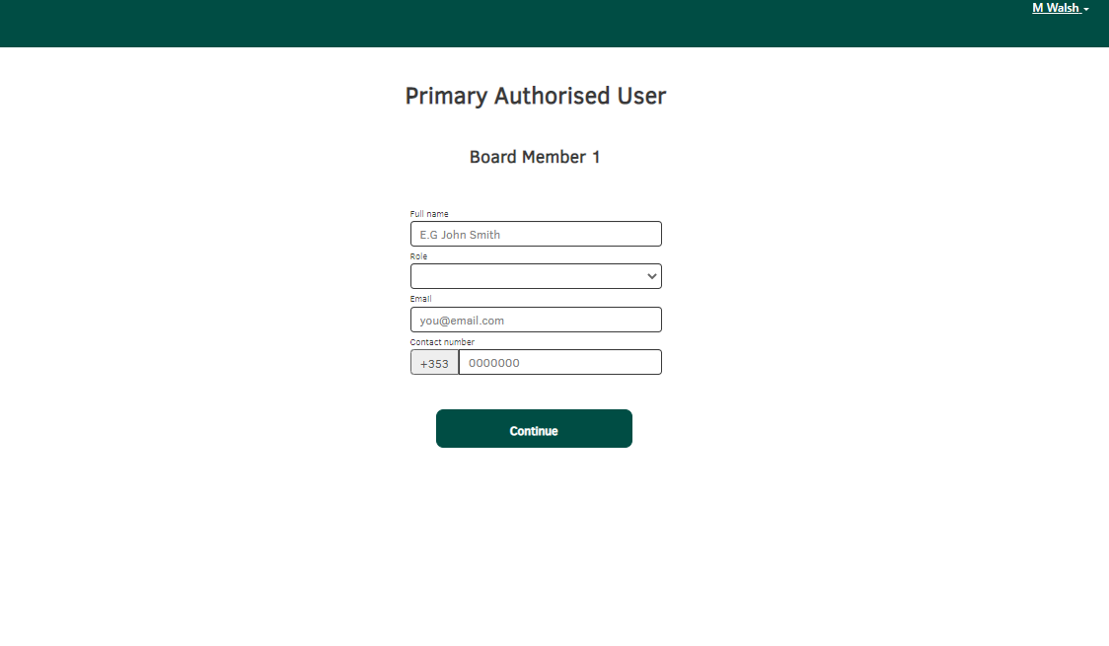
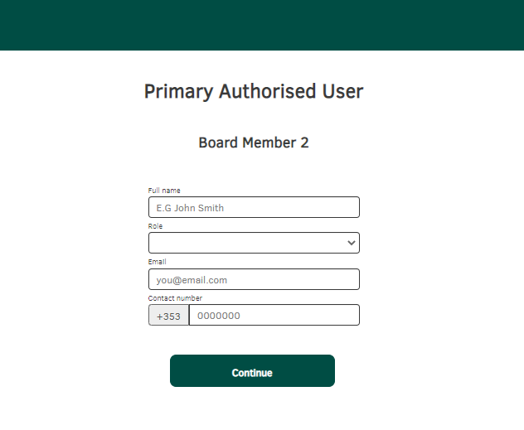
Ideally, add 2 unique Board/Committee members.
We will accept 1 Board/Committee member & PAU
Notes:
Replacement
Email addresses cannot be changed once submitted. – Confirm and Submit

Slide 47
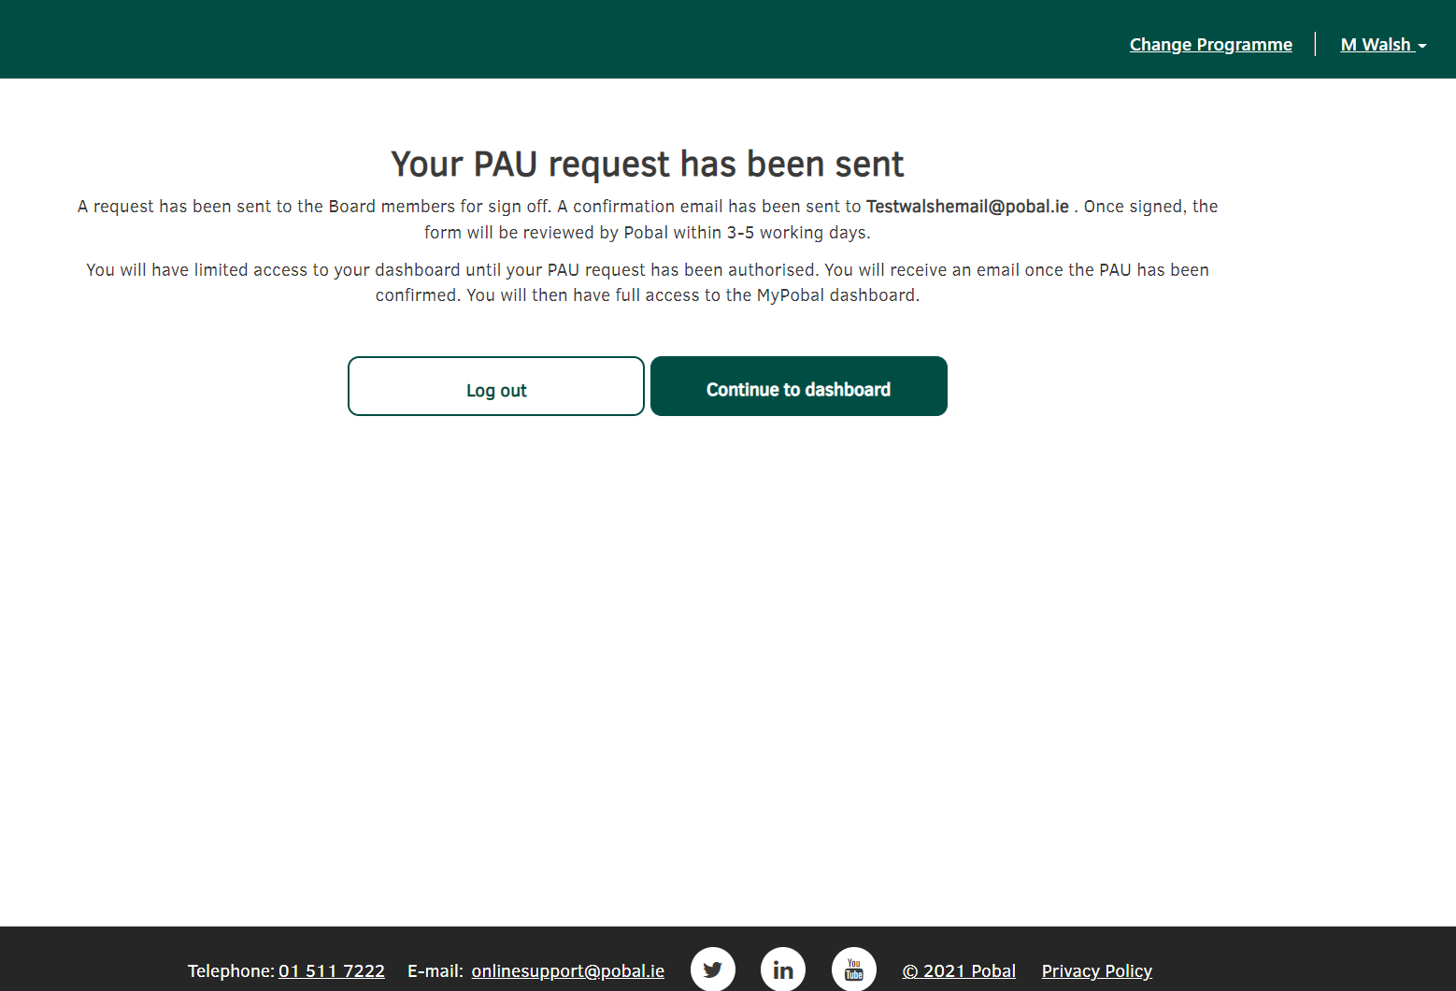

Slide 48
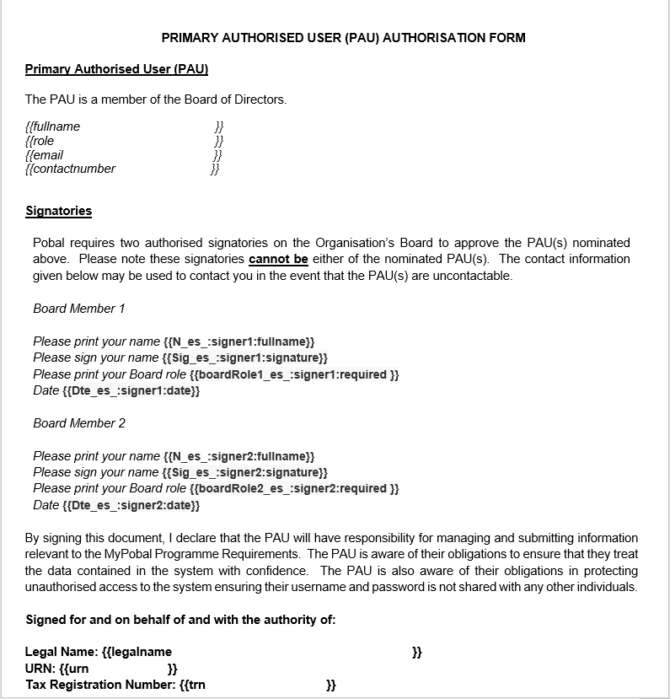
Notes:
There will be weekly reminder emails

Slide 49
Questions and Answers

Slide 50
Poll and Evaluation

Slide 51
Supports, Key Dates & Resources

Slide 52
Dates for Information Sessions & Support Clinics
Register for events on the Department Website: gov - Community Centres Investment Fund (www.gov.ie)
Tuesday 2nd July 12:30 to 14:00
Wednesday 10th July 17:30 to 19:00
Procurement Information Session: Date TBC
Application Clinic: Wednesday 7th August 12:30 to 14:00
Application Clinic: Tuesday 20th August 17:30 to 19:00

Slide 53

Key Dates and Resources
Today: Resources available: gov.ie - Community Centres Investment Fund
Register now!
29 July: Online application open
29 August: Submission deadline
Specific queries: onlinesupport@pobal.ie

Slide 54
Thank you

