Slide 1
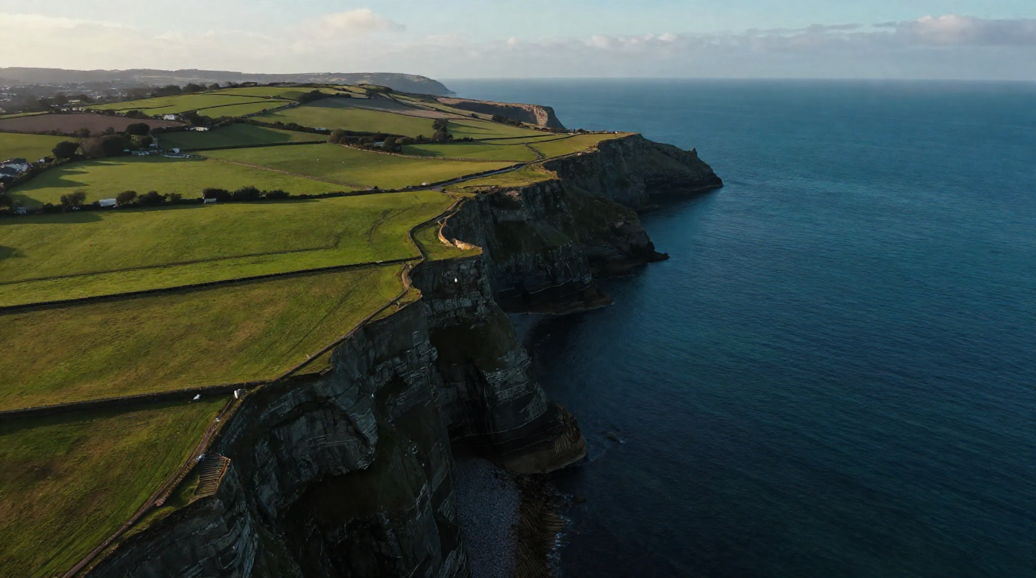


Local Environmental Action Fund
  Communities Working Together for Climate

Slide 2
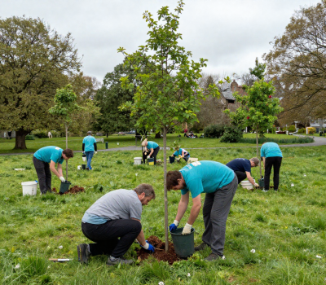
Introducing the Local Environmental Action Fund
A new grant scheme supported by IPB Insurance and Waterford City & County Council to support local community-led environmental projects.
100% funding for project, €1,000 - €25,000.
Enhance Biodiversity
Reduce Waste
Improve Green Spaces
Promote Sustainability

Slide 3




Who Can Apply & How?
Tidy Towns and voluntary groups undertaking similar activities in Waterford are invited to apply for funding.
Tidy Towns and voluntary groups undertaking similar activities collaborate with at least one local partners such as schools, youth groups, community groups, Mens Shed, sports clubs etc.
Deliver environmental and climate action projects of various sizes.
Groups must be registered with Waterford PPN
Apply online at www.waterfordcouncil.ie by 24/07/26

Slide 4
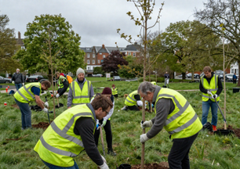

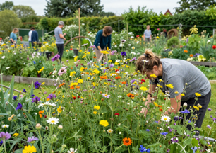
What type of projects are eligible?
Projects must focus on climate action, biodiversity and/or
environmental enhancement.
Examples include but not limited to:
  Biodiversity conservation (e.g.,creating pollinator-friendly spaces)
  Tree planting and urban greening initiatives
  Waste reduction initiatives
  Water conservation projects
  Public education campaigns on sustainability
  Climate resilience projects (e.g. flood prevention measures)

Slide 5

Application Evaluation
Relevance to Climate Action/Environmental Enhancement Goals (40%)
Community Engagement and Impact (20%)
Feasibility and Sustainability (20%)
Innovation and Creativity (20%)

Slide 6
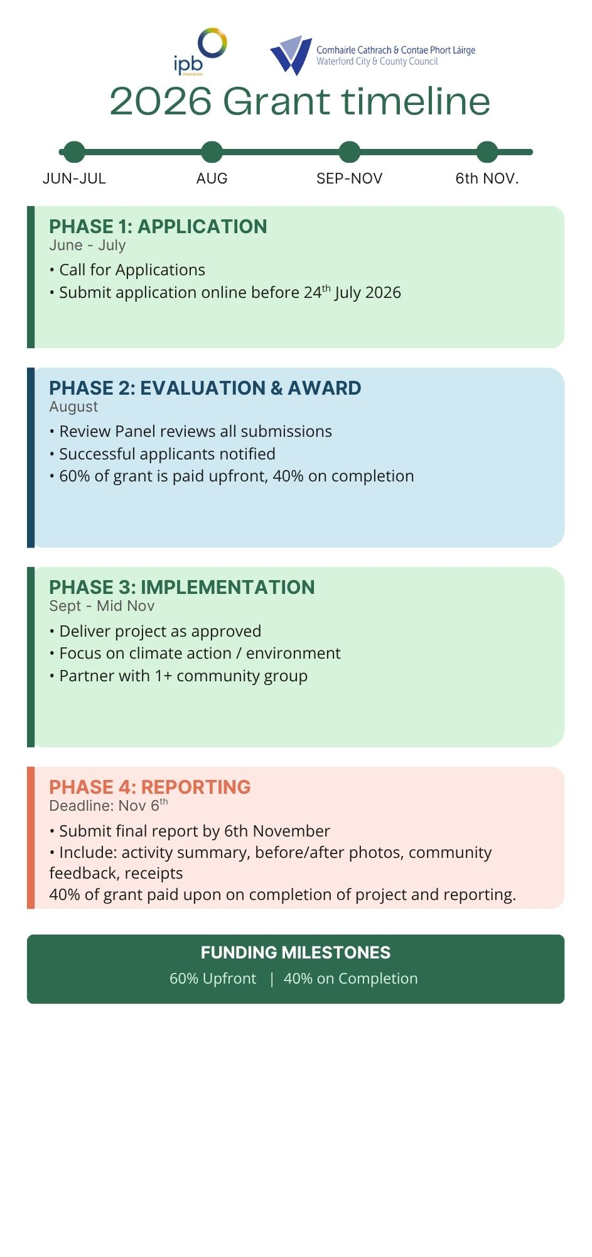

Slide 8
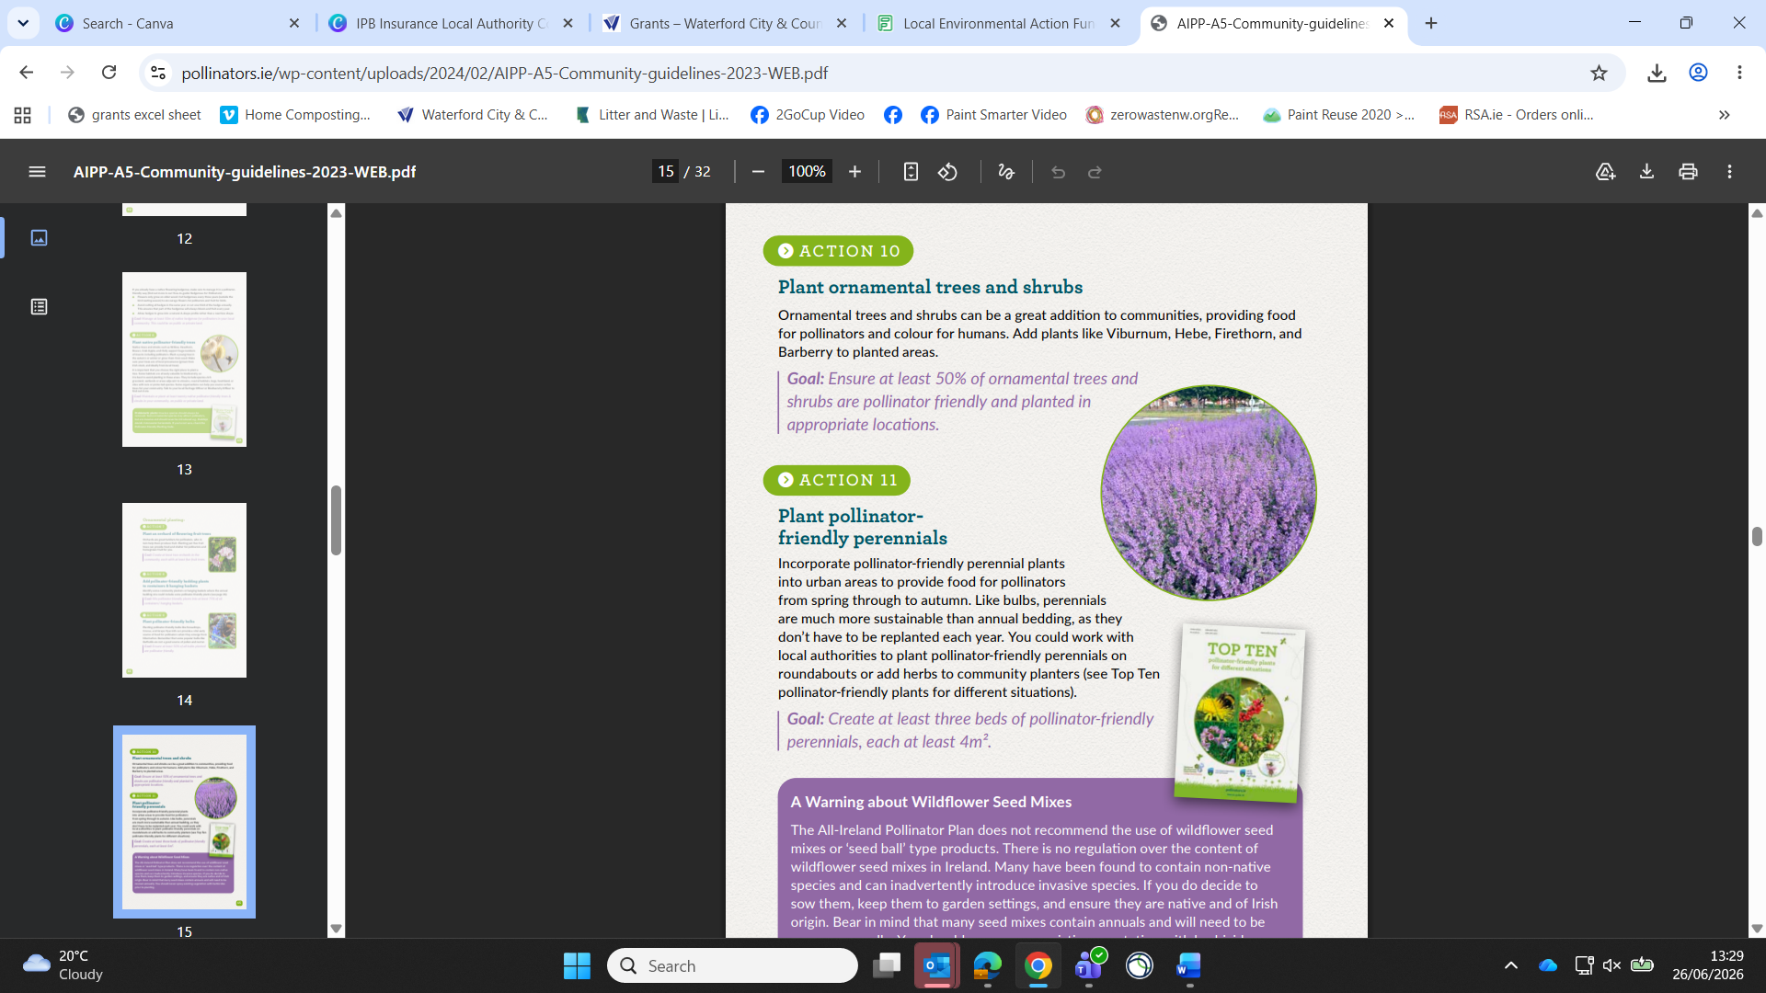

Examples of Potential Projects
– Enhancing Biodiversity
Practical, community-led initiatives to increase local biodiversity and create thriving natural habitats.
  Carry out surveys and create a local biodiversity action plan
  Plant pollinator-friendly native hedgerows, trees and planting.
See www.pollinators.ie for ideas
  Create Pollinator and Wildlife Habitats
  Install Bird & Bat Boxes
  Raise awareness of biodiversity

Slide 9
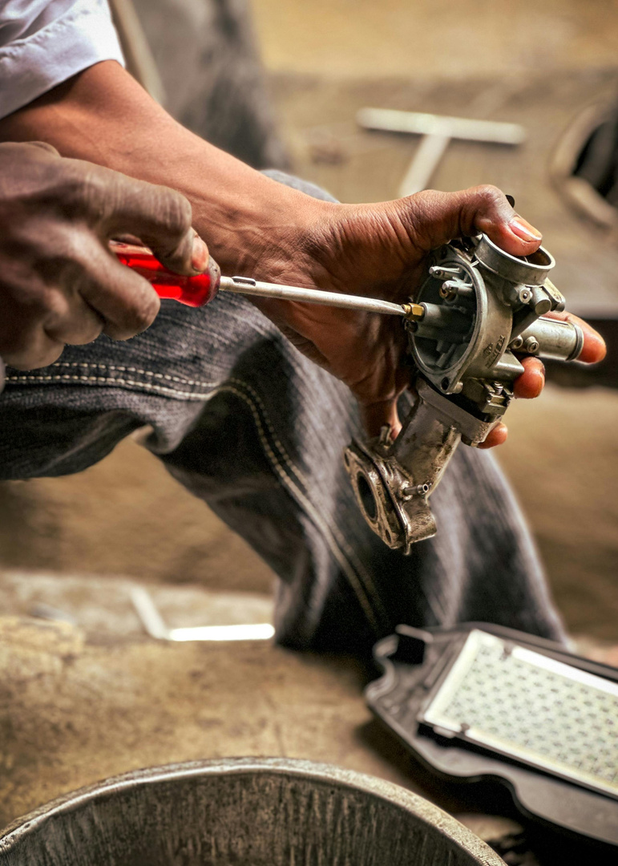

Examples of potential projects
– Waste Reduction
Community actions that reduce waste & encourage reuse and repair.
  Set Up Community Reuse Schemes e.g. tool library
  Run Repair & Waste Minimisation Workshops to upskill the community
  Reduce Food Waste Across the Community
  A residents' association registered with the PPN, collaborating with a local sports club to establish a repair or reuse initiative in the community.

Slide 10
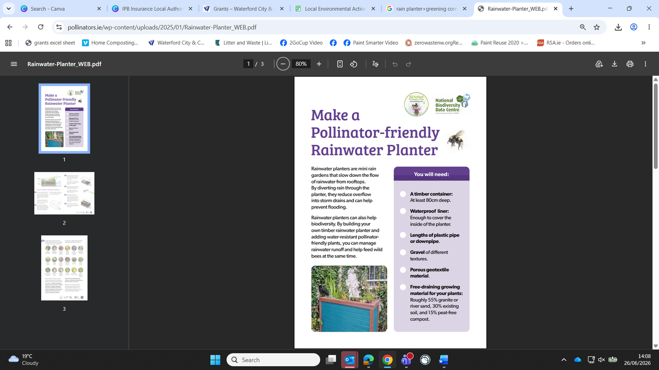
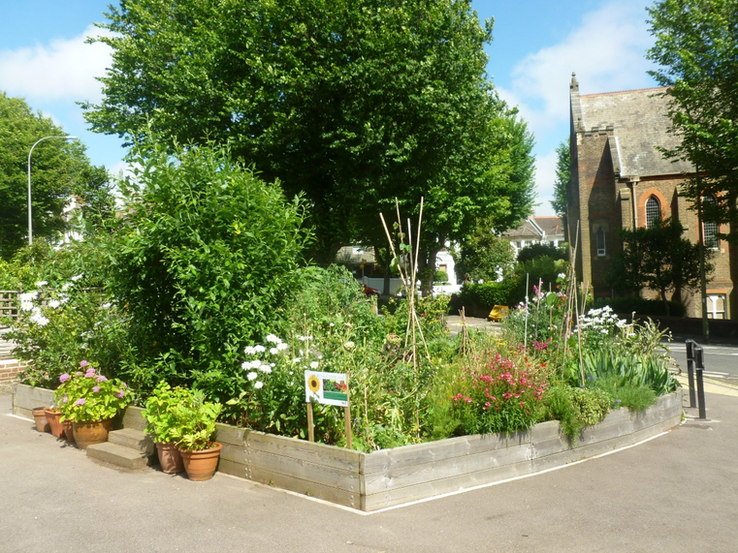
Examples of Project Ideas – Improving Green Spaces
Transform public areas into vibrant, accessible and wildlife-friendly spaces for everyone.
  Create a shaded space in your community to regulate temperature by planting native trees
  Develop a rain garden/ planter to manage flood risks and capture rainwater
  No space? Create a pocket garden for herbs
  A Tidy Towns committee coordinates with a Men’s Shed to build rainwater planters and works with a local school to plant and care for them.

Slide 11

Thank You for Your Interest in the Local Environmental Action Fund
Get in Touch Today!

